Slide 1
DD2380 ARTIFICIAL INTELLIGENCE Hidden Markov Models
Daiki Shirafuji
daikish@kth.se
Jiameng Bian
jiamengb@kth.se

Slide 2
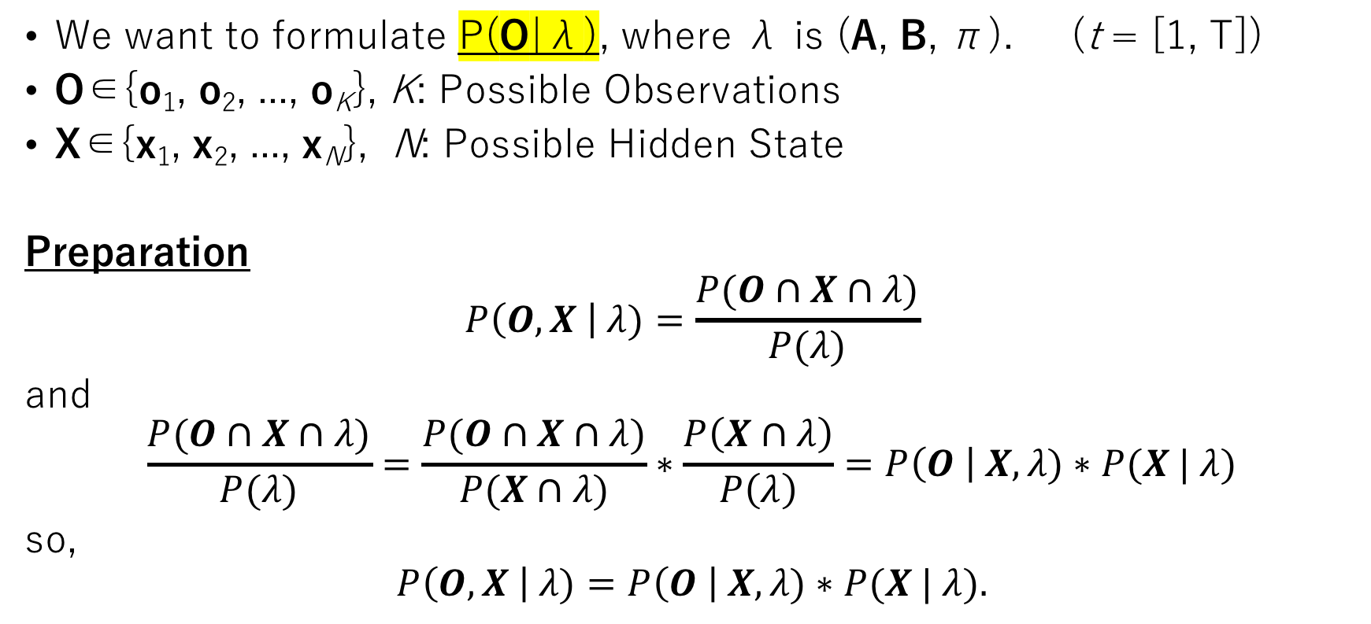
Question 1: This problem can be formulated in matrix form. Please specify the initial probability vector π, the transition probability matrix A and the observation probability matrix B.
We want to formulate P(O|λ), where λ is (A, B, π). (t = [1, T])
O∈{o₁, o₂, ..., o_{K}}, K: Possible Observations
X∈{x₁, x₂, ..., x_{N}}, N: Possible Hidden State
Preparation
$$P\left(O, X \right| λ)=\frac{P(O∩X∩λ)}{P(λ)}$$
and
$$\frac{P(O∩X∩λ)}{P(λ)}=\frac{P(O∩X∩λ)}{P(X∩λ)}∗\frac{P\left(X∩λ\right)}{P\left(λ\right)}=P\left(O \right| X, λ)∗P(X | λ)$$
so,
$$P\left(O, X \right| λ)=P\left(O \right| X, λ)∗P(X | λ).$$
A
X t-1
X t
B
O t

Slide 3
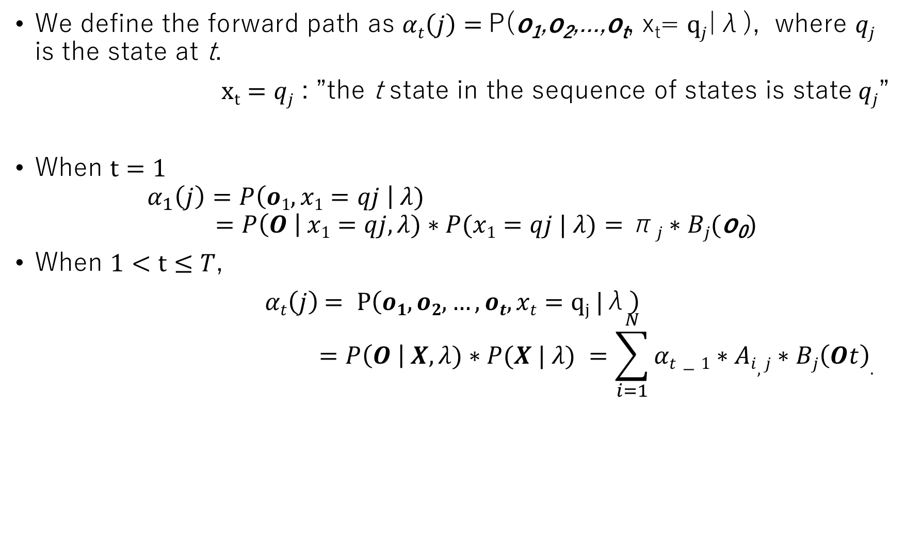
Question 1: This problem can be formulated in matrix form. Please specify the initial probability vector π, the transition probability matrix A and the observation probability matrix B.
We define the forward path as $αt\left(j\right)=$P(o₁,o₂,...,o_{t}, x_{t}= $qj$|λ), where $qj$ is the state at t.
$xt=qj$ : ”the t state in the sequence of states is state$qj$”
When $t=1$
$$α_{1}\left(j\right)=P\left(o1, x1=qj \right| λ) \\ =P\left(O \right| x1=qj, λ)∗P(x1=qj | λ)=\text{π}j∗Bj(\text{o}\text{0})$$
When $1<t≤T$,
$αt\left(j\right)$ $= P\left(o1, o2, …, ot, xt=qj |\text{λ}\right)$
$$=P\left(O \right| X, λ)∗P(X | λ) =\sum_{i=1}^{N}{αt−1∗Ai,j∗Bj\left(Ot\right).}$$

Slide 4
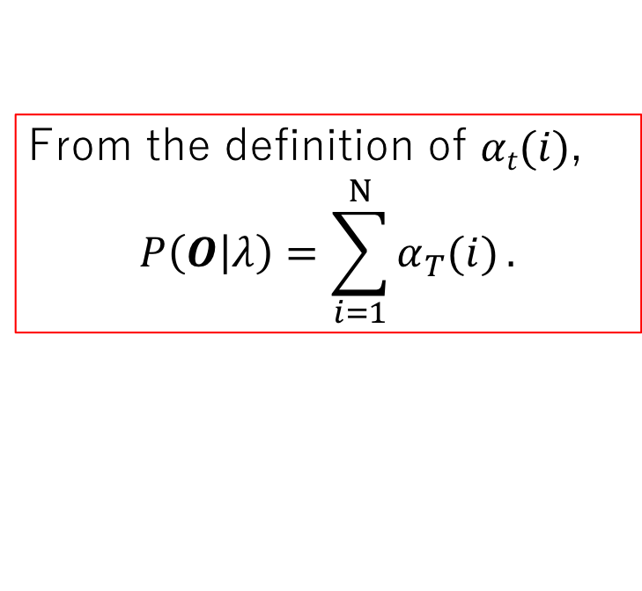

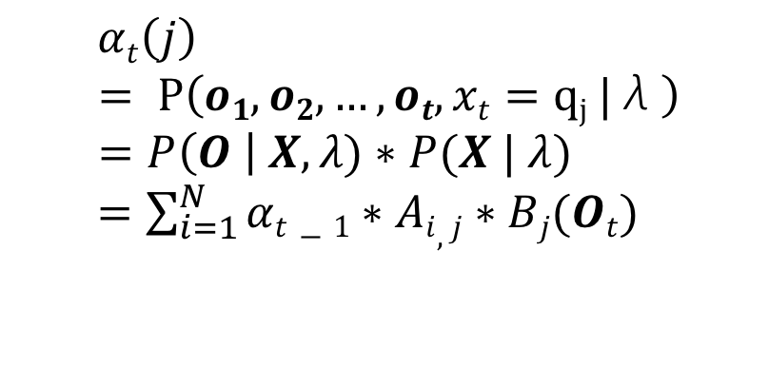


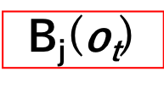

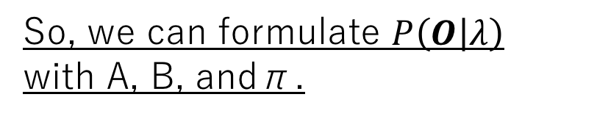
Question 1: This problem can be formulated in matrix form. Please specify the initial probability vector π, the transition probability matrix A and the observation probability matrix B.
t-1
t
$αt\left(j\right)$
$$= P\left(o1, o2, …, ot, xt=qj |\text{λ}\right) \\ =P\left(O \right| X, λ)∗P(X | λ)$$
$=\sum_{i=1}^{N}{αt−1∗Ai,j∗Bj(Ot)}$
q₁
q₁
$$αt−1(1)$$
A_{1, j}
q₂
From the definition of $αt(i)$,
$$P\left(O | λ\right)=\sum_{i=1}^{Ν}{α_{T}(i)}.$$
$$αt−1(2)$$
A_{2, j}
q_{j}
$αt$(j)
A_{N, j}
B_{j}($\text{o}\text{t}$)
So, we can formulate $P\left(O | λ\right)$ with A, B, and$\text{π}\text{.}$
q_{N}
q₁
$$αt−1(N)$$
O_{t}

Slide 5
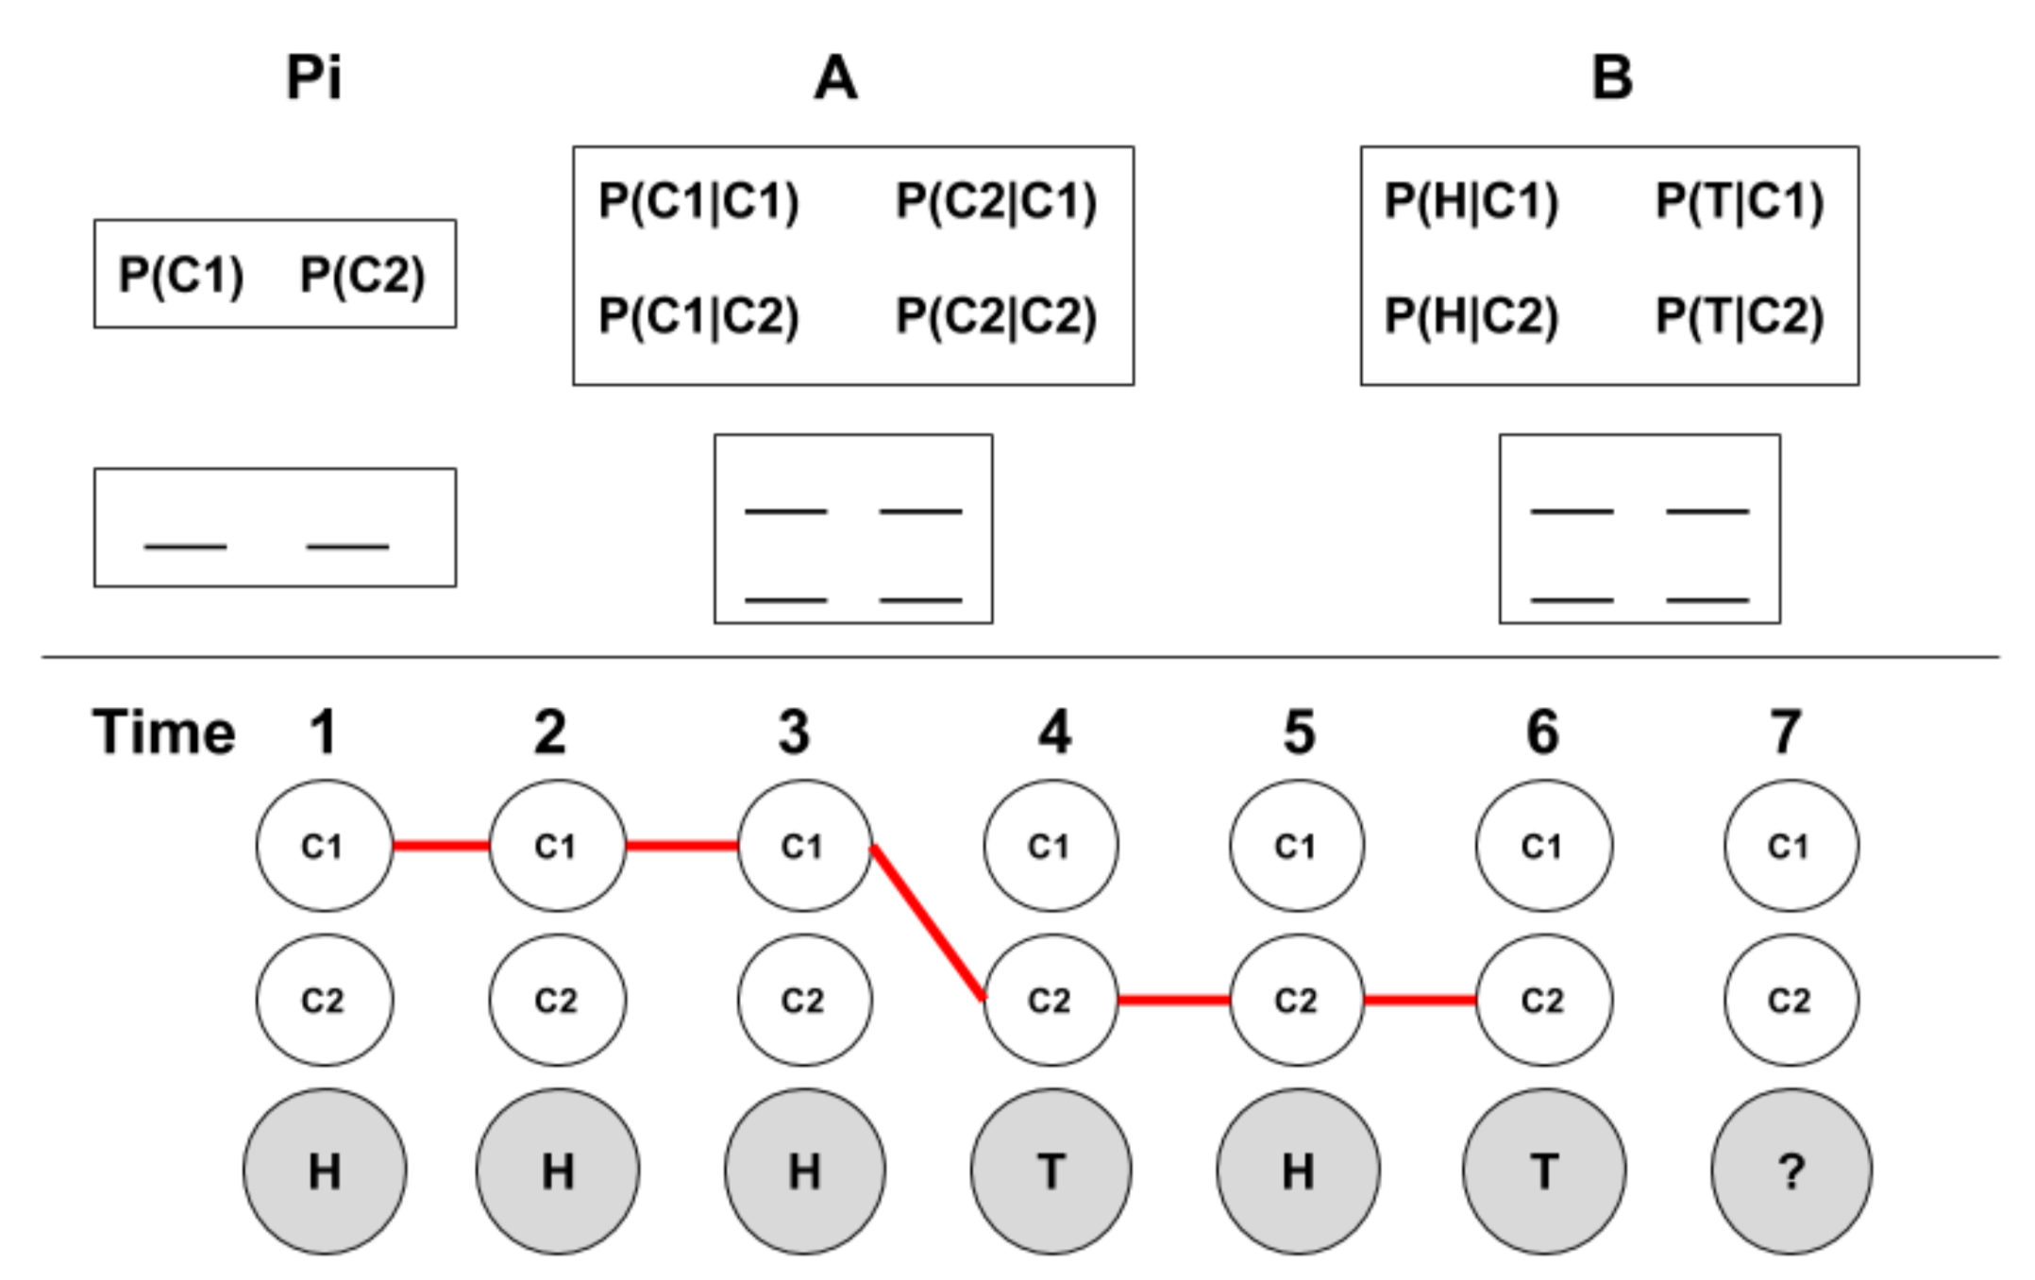
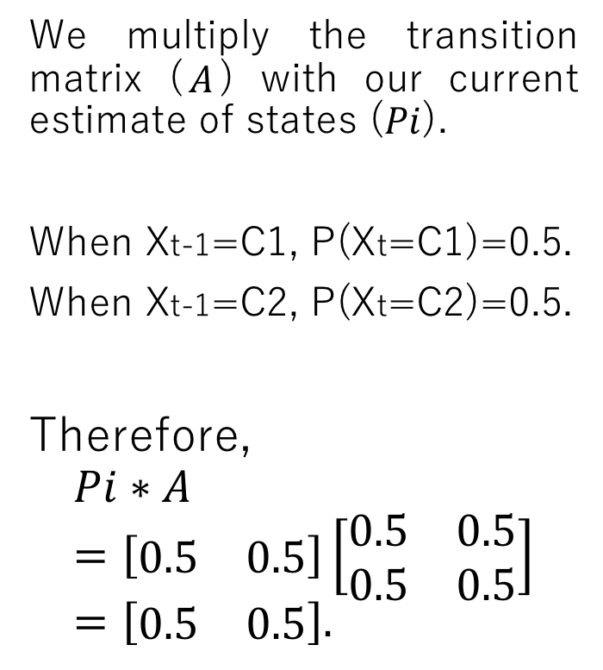
Question 2: What is the result of this operation?
We multiply the transition matrix ($A$) with our current estimate of states ($Pi$).
When Xt-1=C1, P(Xt=C1)=0.5.
When Xt-1=C2, P(Xt=C2)=0.5.
Therefore,
$$Pi∗A=\left[\begin{matrix}0.5 & 0.5\end{matrix}\right]\left[\begin{matrix}0.5 & 0.5 \\ 0.5 & 0.5\end{matrix}\right]=\left[\begin{matrix}0.5 & 0.5\end{matrix}\right].$$
0.5
0.5
0.5
0.5
0.9
0.1
0.5
0.5
0.5
0.5

Slide 6
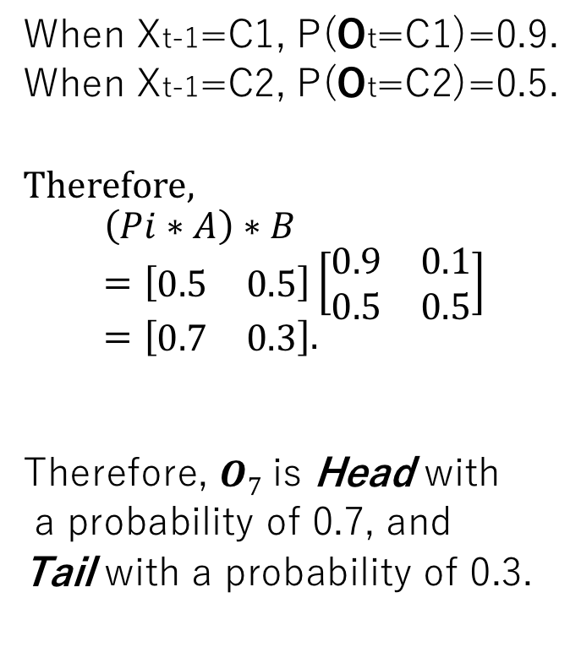
Question 3: What is the result of this operation?
When Xt-1=C1, P(Ot=C1)=0.9.
When Xt-1=C2, P(Ot=C2)=0.5.
Therefore,
$$\left(Pi∗A\right)∗B=\left[\begin{matrix}0.5 & 0.5\end{matrix}\right]\left[\begin{matrix}0.9 & 0.1 \\ 0.5 & 0.5\end{matrix}\right]=\left[\begin{matrix}0.7 & 0.3\end{matrix}\right].$$
Therefore, $O7$ is Head with
a probability of 0.7, and
Tail with a probability of 0.3.
0.5
0.5
0.5
0.5
0.9
0.1
0.5
0.5
0.5
0.5

Slide 7
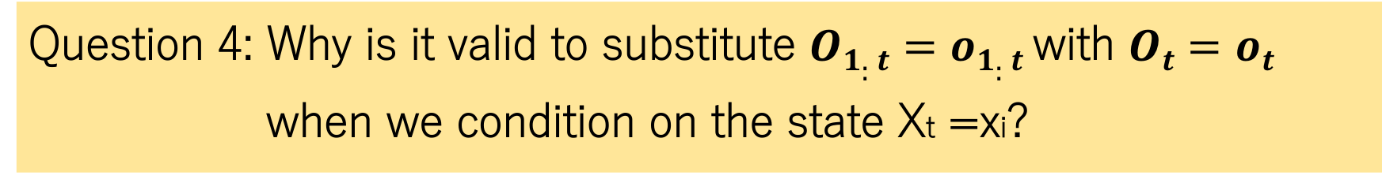
Question 4: Why is it valid to substitute $O1:t=o1:t$ with $Ot=ot$ when we condition on the state Xt =xi?
When Xt=xi is given, we can ignore O1:t-1 because there is no arrow from O1:t-1 to Ot.
X 1
X 2
X t-1
X t
X t+1
O 1
O 2
O t-1
O t
O t+1

Slide 8
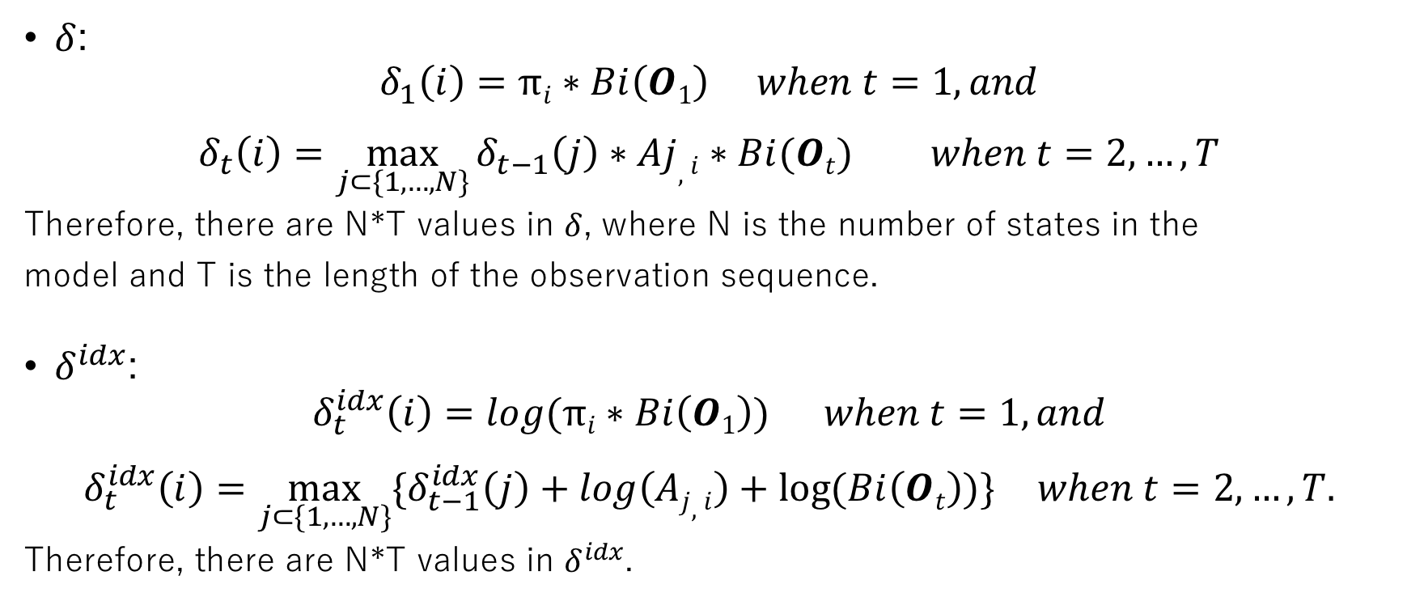
Question 5: How many values are stored in the matrices δ and δ^{i d x} respectively?
$δ$:
$$δ_{1}\left(i\right)=πi∗Bi\left(O1\right) when t=1, and$$
$$δ_{t}\left(i\right)=\max_{j⊂\{1,…, N\}}{δ_{t−1}\left(j\right)∗Aj,i∗Bi(Ot)} when t=2, …, T$$
Therefore, there are N*T values in $δ$, where N is the number of states in the
model and T is the length of the observation sequence.
$δ^{idx}$:
$$δ_{t}^{idx}\left(i\right)=\log{(πi∗Bi\left(O1\right))} when t=1, and$$
$$δ_{t}^{idx}\left(i\right)=\max_{j⊂\{1,…, N\}}{{\{δ}_{t−1}^{idx}\left(j\right)+\log\left(Aj, i\right)+log⁡(Bi\left(Ot\right))\}} when t=2, …, T.$$
Therefore, there are N*T values in $δ^{idx}$.

Slide 9
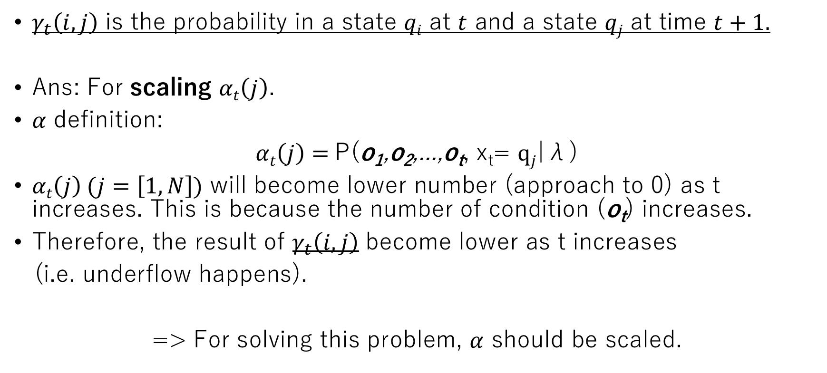
Question 6: Why we do we need to divide by the sum over the final α values for the di-gamma function?
$γ_{t}\left(i,j\right)$ is the probability in a state $qi$ at $t$ and a state $qj$ at time $t+1.$
Ans: For scaling $αt\left(j\right)$.
$α$ definition:
$αt\left(j\right)=$P(o₁,o₂,...,o_{t}, x_{t}= $qj$|λ)
$αt\left(j\right) (j=\left[1, N\right])$ will become lower number (approach to 0) as t increases. This is because the number of condition (o_{t}) increases.
Therefore, the result of $γ_{t}\left(i,j\right)$ become lower as t increases
(i.e. underflow happens).
=> For solving this problem, $α$ should be scaled.

Slide 10

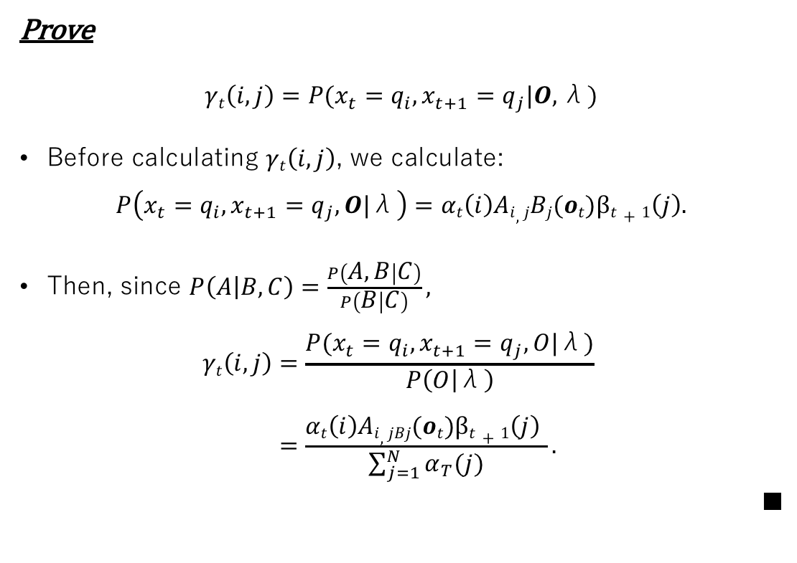




Question 6: Why we do we need to divide by the sum over the final α values for the di-gamma function?
Prove
$$γt\left(i, j\right)=P(x_{t}=q_{i},x_{t+1}=q_{j}|O,\text{λ})$$
Before calculating $γt\left(i, j\right)$, we calculate:
$$P\left(x_{t}=q_{i},x_{t+1}=q_{j}, O|\text{λ}\right)=αt\left(i\right)Ai,jBj(ot)βt+1\left(j\right).$$
Then, since $P\left(A | B,C\right)=\frac{P\left(A,B | C\right)}{P\left(B | C\right)},$
$$γt\left(i, j\right)=\frac{P(x_{t}=q_{i},x_{t+1}=q_{j}, O|\text{λ})}{P\left(O | \text{λ}\right)}$$
$$=\frac{αt\left(i\right)Ai,jBj(ot)βt+1\left(j\right) }{\sum_{j=1}^{N}{α_{T}(j)}}.$$
■
$$q_{i}$$
$$q_{j}$$
$$αt\left(i\right)$$
A_{i, j}*B_{j}($\text{o}\text{t}$)
$$βt+1\left(j\right)$$
O i
O j

Slide 11
Appendix 1: The Forward Algorithm
Also called α-pass.
To find P(O|λ).
α_{t} (i) is the probability of the partial observation sequence up to time t, where the underlying Markov process is in state qi at time t.

Slide 12
Appendix 2: The Viterbi Algorithm
Also called β-pass.
To find the most likely state sequence.
β_{t} (i) it starts at the end and works back toward the beginning.

Slide 13
Appendix 3: The Forward-Backward Algorithm
Also called Baum-Welch Algorithm
For Estimation of Appropriate Model Parameters
Estimate the model λ=(A,B,π) to find the one that maximizes P (O|λ).
Using α and β.

